Slide 1
Software Testing
Course Instructor
Sobia Usman

Slide 2
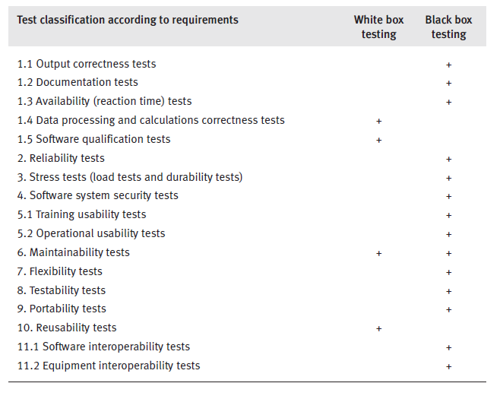
Black box testing allows us to perform output correctness tests and most classes of tests as shown in Table

Slide 3
Equivalence partitioning for output correctness test
Output correctness tests are, in most cases, among the tests that consume the greater part of testing resources.
Improved choice of test cases can be achieved by the efficient use of equivalence class partitioning
Equivalence class partitioning is a black box method aimed at
Increasing the efficiency of testing
Improving coverage of potential error conditions.

Slide 4
Equivalence Partitioning
Equivalence partitioning is a software testing technique that divides the input and/or output data of a software unit into partitions of data
An equivalence class (EC) is a set of input variable values that produce the same output results or that are processed identically
An EC that contains only valid states is defined as a “valid EC”, whereas an EC that contains only invalid states is defined as an “invalid EC”.
EC boundaries are defined by a numeric or alphabetic value
Test cases are defined so that each valid EC and each invalid EC are included in at least one test case.

Slide 5
Recommendations on defining Partitions
All valid input data for a given condition are likely to go through the same process.
Invalid data can go through various processes and need to be evaluated more carefully. For example:
A blank entry may be treated differently than an incorrect entry
A value that is less than a range of values may be treated differently than a value that is greater

Slide 6
Equivalence partitioning example
Example of a function which takes a parameter “month”.
The valid range for the month is 1 to 12, representing January to December. This valid range is called a partition.
In this example there are two further partitions of invalid ranges.
x < 1
1 ≤ x ≤ 12
12 < x

Slide 7
Equivalence Partitioning example
Test cases are chosen so that each partition would be tested.
-2
5
17
x < 1
1 ≤ x ≤ 12
12 < x

Slide 8
Exercise 1
A text field permits only numeric characters
Length must be 6-10 characters long
Derive valid / invalid equivalence classes
Write test cases for valid/invalid equivalence classes derived in part ‘a’.

Slide 9
Boundary Value Analysis
According to the definition of equivalence classes, one test case should be sufficient for each class. However, when equivalence classes cover a range of values (e.g. monthly income, apartment area)
The tester has a special interest in testing border values when these are considered to be error prone.
In these cases, the preparation of three test cases – for mid range, lower boundary and upper boundary values – is recommended.

Slide 10
Equivalence Partitioning with Boundary Value Analysis
We use the same example as before.
Test cases are supplemented with boundary values.
-2
1
5
12
17
x < 1
1 ≤ x ≤ 12
12 < x

Slide 11
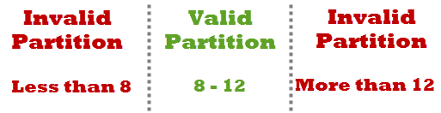
Equivalence Partitioning with Boundary Value Analysis
Suppose you have very important tool at office, accepts valid User Name and Password field to work on that tool, and accepts minimum 8 characters and maximum 12 characters. Valid range 8-12, Invalid range 7 or less than 7 and Invalid range 13 or more than 13.
Write Test Cases for Valid partition value, Invalid partition value and exact boundary value.

Slide 12
Solution:
Test Cases 1: Consider password length less than 8.
Test Cases 2: Consider password of length exactly 8.
Test Cases 3: Consider password of length between 9 and 11.
Test Cases 4: Consider password of length exactly 12.
Test Cases 5: Consider password of length more than 12.

Slide 13
Exercise 2
Consider a software module that is intended to accept the name of a grocery item and a list of the different sizes the item comes in, specified in ounces . The specifications state that the item name is to be alphabetic characters 2 to 15 characters in length. Each size may be a value in the range of 1 to 48, whole numbers only. The sizes are to be entered in ascending order (smaller sizes first). A maximum of five sizes may be entered for each item. The item name is to be entered first, followed by a comma, and then followed by a list of sizes. A comma will be used to separate each size. Spaces (blanks) are to be ignored anywhere in the input.

Slide 14
Equivalence Classes:
1. Item name is alphabetic (valid)
2. Item name is not alphabetic (invalid)
3. Item name is less than 2 characters in length (invalid)
4. Item name is 2 to 15 characters in length (valid)
5. Item name is greater than 15 characters in length (invalid)
6. Size value is less than 1 (invalid)
7. Size value is in the range 1 to 48 (valid)
8. Size value is greater than 48 (invalid)
9. Size value is a whole number (valid)
10. Size value is a decimal (invalid)
11. Size value is numeric (valid)
12. Size value includes nonnumeric characters (invalid)
13. Size values entered in ascending order (valid)
14. Size values entered in non ascending order (invalid)

Slide 15
Equivalence Classes
15. No size values entered (invalid)
16. One to five size values entered (valid)
17. More than five sizes entered (invalid)
18. Item name is first (valid)
19. Item name is not first (invalid)
20. A single comma separates each entry in list (valid)
21. A comma does not separate two or more entries in the list (invalid)
22. The entry contains no blanks (valid)
23. The entry contains blanks (valid)

Slide 16
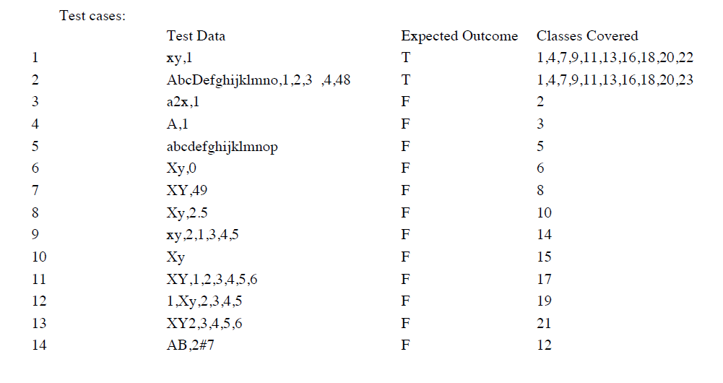

Slide 17
Exercise 3
The software module calculates entrance ticket prices
The ticket price depends on four variables:
Day (weekday, weekend)
visitor’s status (OT = one time, M = member),
Entry hour (6.00–19.00,19.01–24.00)
visitor’s age (up to 16, 16.01–60, 60.01–120).

Slide 18
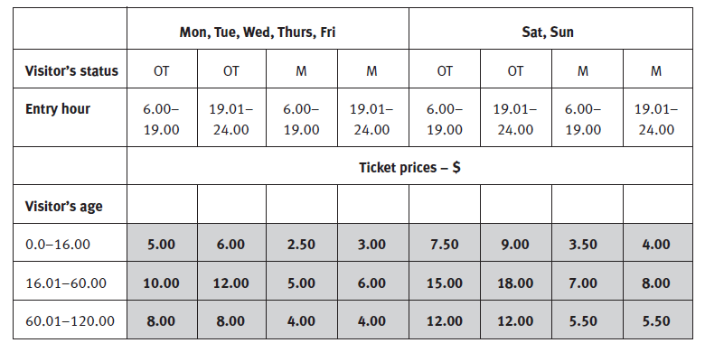
The entrance ticket price table is given below

Slide 19
Q1:Write three test cases to deal with boundary value situations.

